Slide 1
Instructions
To advance through the instructions, click on the “forward” button ( ). If you need to return to an earlier instruction page, click on the “back” button ( ).
If at any time you have a question, please raise your hand, and someone will come by to help you.
Click on the forward button to continue.

Slide 2
In this experiment, you will be shown a sequence of pictures, one picture per slide. For each picture you are shown, you will have to rate your concern in a scale from 0 to 10 when asked.

Slide 3
For example, you will be shown a sequence of pictures like the following one:

Slide 4
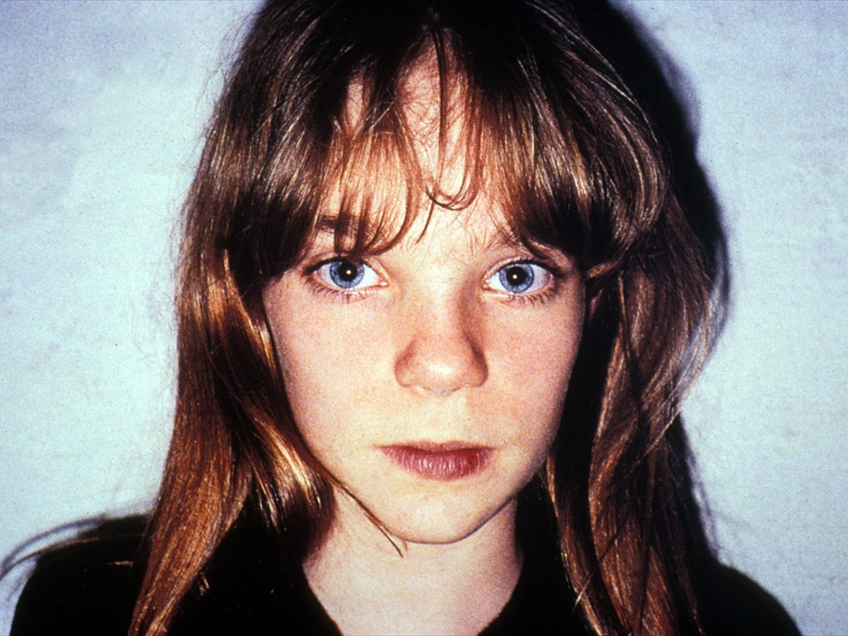

Slide 5
After the picture is shown in a slide, you will be asked for your concern about it, and you will rate it in a scale from 0 to 10 with the scaling device arranged for you during the scanning session.

Slide 6
You should understand the instructions before continuing. If they are not clear, go back and read them again, or ask the experimenters a question.

